Slide 1
Final Project Presentation Estimation of Object Dimension using Image Processing Programme: B.Tech in CSE

Slide 2
Group Details
Sl.No. | Reg. No. | Name of the student | Department
1 | 16ETCS002122 | Shivakumar M | CSE
2 | 16ETCS002124 | Shridhar Hegde | CSE
3 | 16ETCS002112 | Santosh G | CSE
4 | 16ETCS002116 | Sai Bharadwaj | CSE
Batch : FET - 2016

Slide 3
Title of the Project
Estimation of Object Dimension using Image Processing
Supervisors
Supervisor 1: Mr. Prakash P
Supervisor 2: Ms. Pallavi R Kumar
Place of Work: Ramaiah University of Applied Sciences

Slide 4
Outline
Introduction
Motivation(Project Concept and its relevance)
Aims and Objectives
Title, Aim, Objectives, Methods and Methodology
Problem Solving
Project Concept, Design, Development or Implementation, Testing
Outcomes-
Working Model/Prototype/Tool/Patent/ New Process/ Procedure/ Design/ Technique
Project Costing
Conclusions
References
Demonstration
Workload Allocation
Team Experience
Report Writing and Uploading Product video on YouTube

Slide 5
Introduction
Scientists and Engineers need to often build physical models for their experiments. Even professors need to examine models built by students to grade them. The whole process of carrying measuring instruments everywhere is cumbersome. The current project aims to solve such problems.

Slide 6
Motivation (Project Concept and its relevance)
Computing has become so inexpensive that everyone carries a camera enabled computer in their pocket (cellphones)
Engineers and Scientists constantly build physical scientific models & need to ascertain it’s dimensions
It is cumbersome to carry around standard measuring instruments
Applying the knowledge of Image Processing can solve this problem if one can obtain the pictures of the objects customarily using cellphone camera

Slide 7
Aims and Objectives
Title
Estimation of Object Dimension using Image Processing
Aim
To develop a system to estimate the dimensions of a given object using Image Processing techniques

Slide 8
Objectives
To conduct literature survey on image processing, depth and geometry prediction using triangulation
To analyze the literature survey and derive the requirements for building system to find the dimensions of an object in an image
To design a mathematical model for depth analysis and to measure dimensions of an object

Slide 9
Objectives cont…
To implement the designed mathematical model using appropriately chosen programming languages and tools
To test and validate the system built for different cases considered and incorporate necessary changes
To document the report by unifying all the results and outcomes

Slide 10
Methods and Methodologies
To conduct literature survey on
1.1: Parallax method to compute the dimensions of object
when the viewpoint changes
1.2: Reference object method, scale of a reference object to
compute the dimensions of the object
1.3: Image pre-processing and processing, Object
segmentation in an image

Slide 11
Methods and Methodologies cont..
To analyze the literature survey and finding the requirements
2.1: Compare different methods found in the literature
survey to find the dimensions of the object in an
image
2.2: Based on the analysis, find the functional and non-
functional requirements
2:3 Check feasibility for the identified requirements

Slide 12
Methods and Methodologies cont..
To design and implement a mathematical model for depth analysis and to measure dimensions of an object
3.1: A high-level block diagram is designed to identify
primary functionalities of the system
3.2: A mathematical model to compute the dimensions
from a theoretical aspect is built
3.3: A low-level block diagram is then designed to
represent the functions that inputs an image,
processes the image, separates the object from
background and outputs the dimensions of the object

Slide 13
Methods and Methodologies cont..
To implement the designed mathematical model using appropriately chosen programming languages and tools
4.1: Identify the appropriate programming language and tools
(mostly free and/or open source) to use based on the
design and requirements
4.2: Develop system that accepts an image as input,
processes it, identifies various objects in it, compute and
returns the dimensions of the object

Slide 14
Methods and Methodologies cont..
To test and validate the system built for different cases considered and incorporate necessary changes
5.1: The system built will be tested for different cases and
find exceptions and anomalies
5.2: Unit test, integration and functional tests will be made to
ensure the product works well in different layers/levels
5.3: Comparison is made between the actual dimensions of an
object and the dimensions given by the system
5.4: The errors and the functionality test case failures (if any)
are identified and changes are incorporated

Slide 15
Methods and Methodologies cont..
To document the report by unifying all the results and outcomes
6.1: A report will be made illustrating the need for the
project, introduction of the project and the related works
in this domain so far
6.2: The various designs made, implementation, testing and
results are reported
6.3: Demonstrate the working of the product built with
sample image as input to the system
6.4: The performance is compared with other existing models
and efficiency, error rate is reported

Slide 16
Problem Solving
Project Concept
Design
Implementation
Testing

Slide 17
Project Concept
Literature survey has been carried out in order to understand different methods which can be used to solve problem at hand
The three main concepts identified to solve the problem are Parallax Method, Reference Object Method and Image Pre-Processing

Slide 18
Project Concept
Parallax method
Parallax means change in position of the object when viewed from different places or line of sight
After thorough research, it was concluded that our camera should be placed in exact perpendicular position to the object
Thus, parallax method was ruled out

Slide 19
Project Concept
Reference Object method
From the input image reference object can be identified either by specifying the position of the reference object like leftmost, rightmost, topmost, bottommost, middle one or by specifying a colour or shape of the reference object which should be unique from other objects in the image
This method was found to be more promising than the other ones found during the literature survey.

Slide 20
Project Concept
Image Pre-Processing
The input image read is converted to grayscale image and is blurred slightly, reducing the noise in the image
Camera should be placed perpendicular to the object
The camera should be placed perpendicular to the objects for which the dimensions are to be measured. If camera is not placed perpendicularly the round object might appear as oval, a rectangular object might appear as square object which will lead to false dimensions of objects

Slide 21
Project Concept
Scale of reference object to compute the dimensions?
Scale for reference object can be in inches or millimetres or centimetres.
After knowing the dimension of reference object in any of the scale mentioned above, the number of pixels occupied for the reference object is calculated.
Each pixel length is calculated by dividing ‘number of pixels occupied’ by ‘length of object’, using this ratio dimensions of other objects in the image are calculated

Slide 22
Design
After analysing the different methods that can be used to solve the problem, Reference Object method has been found to be more feasible than others.
In the design phase, Functional and Non-Functional Requirements of the system have been finalised

Slide 23
Design
Functional Requirements
FR1: System should read the image given as input.
FR2: System should identify the objects from the image
read.
FR3: System should identify corners for each object in read
image.
FR4: System should identify all the edges for objects
present in read image.

Slide 24
Design
Functional Requirements
FR5: System should calculate dimensions of each edge of
these objects using pixel per metric ratio.
FR6: System should calculate the approximate dimensions
based on dimensions of reference object.
FR7: System should produce an image as output showing
the identified edges and dimensions of input image.

Slide 25
Design
Non-Functional Requirements
NF1: System shall produce the output image very quickly.
NF2: System shall take input image of any size.
NF3: System shall be available in any platform to be
executed.
NF4: System shall allow only one image as input with any
number of objects in it.

Slide 26
Design
In order to implement the system, a proper flow of tasks to be achieved has to be designed.
A high level block diagram & a low level block diagram depicting primary functionalities of the system has been designed.
A low level explanation for the block diagram has also been given.

Slide 27
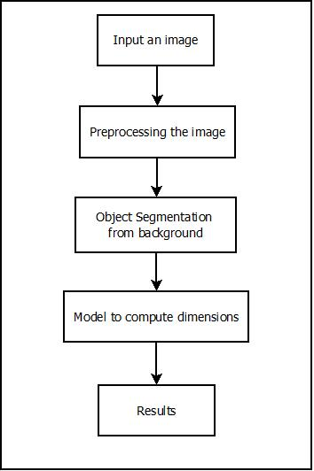
Design
High-level block Diagram

Slide 28
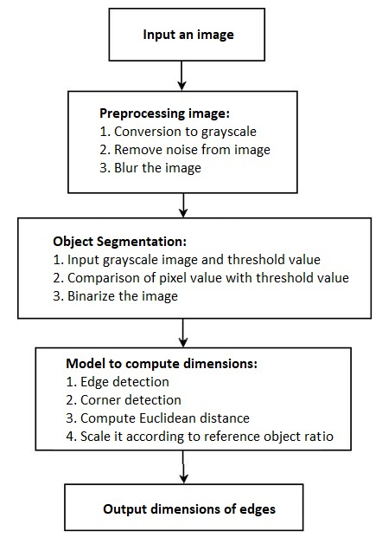
Design
Low-level block
Diagram

Slide 29
Design
Low-level design explanation
Input an image
Input the image of the target object to the system in any standard format
Preprocessing the image
Convert the image to grayscale which helps in segmentation of objects
Remove noise from the image using low pass filters, since noise is an area with high frequency in a single spectrum of the image.
Blur the image to remove other minute objects formed due to light effects

Slide 30
Design
Low-level design explanation
Object segmentation from the background
Input the grayscale image and a threshold value.
For every pixel, compare its value with the threshold value to produce either a low value or a high value for a pixel.
The image will be converted to binary format after these processes

Slide 31
Design
Low-level design explanation
Model to compute dimensions
Use edge detection algorithm (Canny edge detector) to detect the edges in the image.
Use Corner detection algorithm (Harris corner detector) to detect the coordinates of the corners of the edge.
Use the coordinates to compute the Euclidean distance between the corners of every edge and scale it to real world values using the reference object.
Output the result
Output the image along with the object dimensions

Slide 32
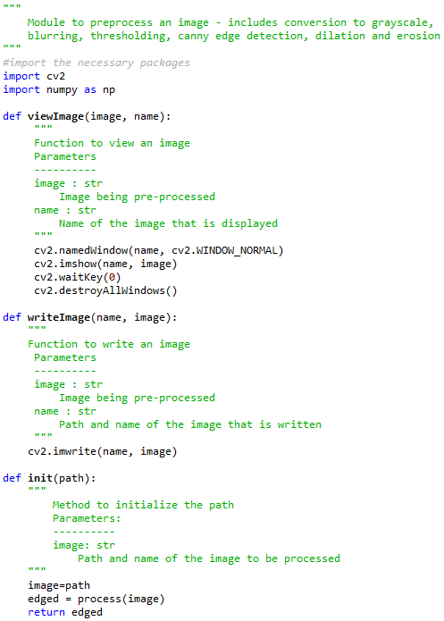
Implementation
Figure 1.1 shows the implementation of the preprocess.py module. In this image viewImage, writeImage and init functions are covered, other function of the module is shown in next slide (slide no.33)
Figure 1.1

Slide 33
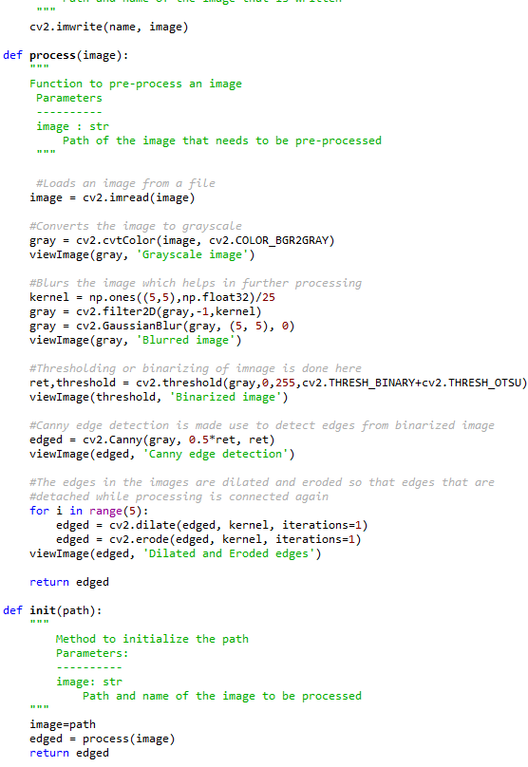
Implementation
Figure 1.2 shows implementation of process function of preprocess.py module.
In a whole preprocess.py module pre-processes the image given to it as an input. Pre-process of image consists of converting the input image to grayscale, then blurring the image, thresholding the blurred image to separate objects from background, finding edges to the objects identified and finally the dilate and erode methods are used to get more clearer outline of the objects of input image.
Figure 1.2

Slide 34
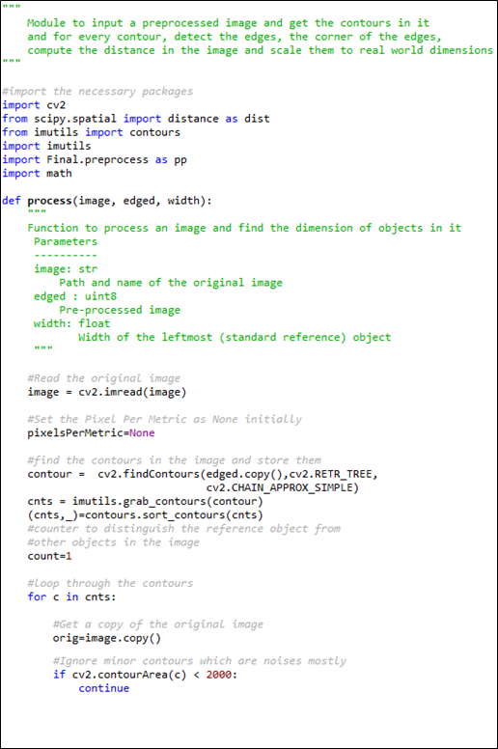
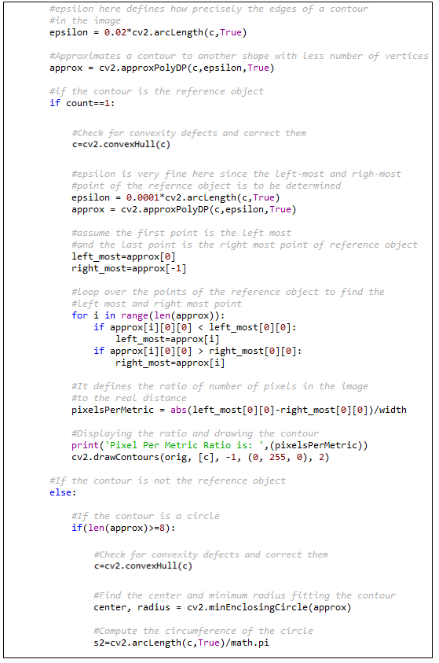
Implementation
Figure 1.3
Figure 1.4

Slide 35
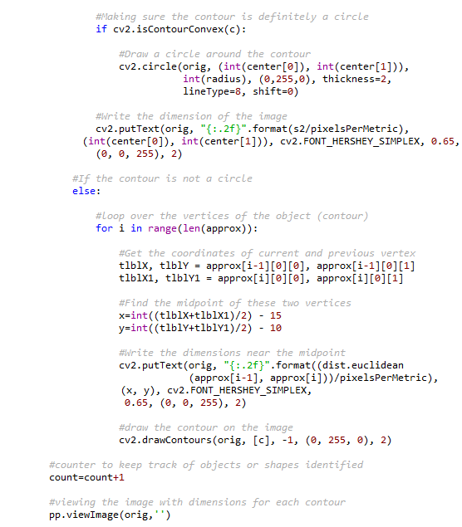
Implementation
The images in the previous slide (slide no.34) and the implementation in figure 1.5 combined, form the implementation of findDimension.py module.
In this module it takes the binarized image (output of preprocess.py) as input and from the input it identifies the reference object and contours, the identified contours are then approximated to objects in the image and its vertices are noted down. Now, initially Euclidean distance of reference object is calculated and by already knowing the dimensions of reference object pixels per metric ratio is calculated using which dimensions of the object in the image is calculated and printed on the image.
Figure 1.5

Slide 36
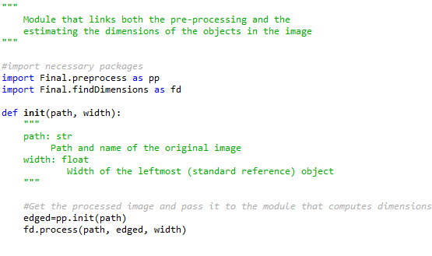
Implementation
Figure 1.6
Figure 1.6 shows the implementation of dim.py module. The dim.py module integrates the pre-processing and finding the dimension functionality (preprocess.py and findDimensions.py modules) into one and all the modules (preprocess.py, findDimensions.py and dim.py) are made available as a package named “Final”.

Slide 37
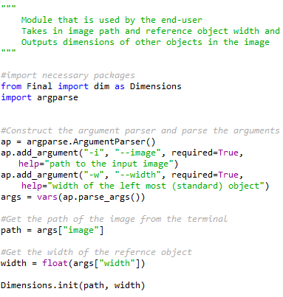
Implementation
Figure 1.7 shows the implementation of User.py module.
This module consists the python code which the end-user has to run on the terminal. The user has to run the python file where one specifies the image path and width of the reference object as arguments. These arguments are parsed and sent to dim.py module of Final package where all the processing of image is done and final output image will be shown to the user with dimensions of object in the image.
Figure 1.7

Slide 38
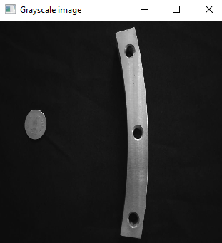
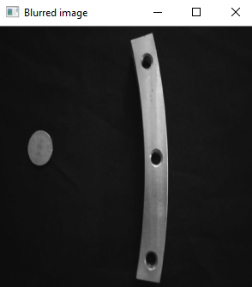
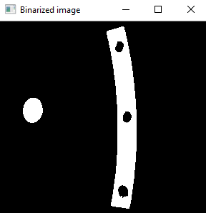
Testing
Test case | Description | Input | Expected Output | Actual Output | Result
1. | Conversion to grayscale | A colour image | A grayscale image |  | Pass
2. | Blur the image | A grayscale image | A blurred image |  | Pass
3. | Binarize the image | Blurred image | Complete black and white image |  | Pass

Slide 39
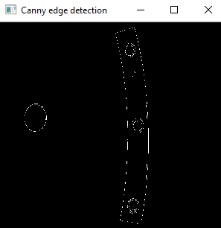
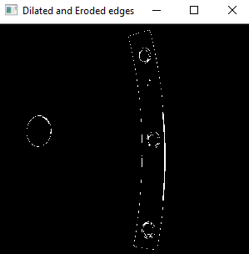
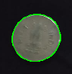
Testing
Test case | Description | Input | Expected Output | Actual Output | Result
4. | Canny edge detection | Threshold image | Image with edges of objects |  | Pass
5. | Dilation and erosion | Edge detected image | Enhanced edges |  | Pass
6. | Get the contours | Image with edges detected | Object with contours around it |  | Pass

Slide 40
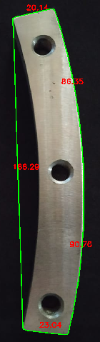
Testing
Test Case | Description | Input | Expected Output | Actual Output | Result
7. | Show dimensions of object | Image with edges detected | Object with its dimensions |  | Pass

Slide 41
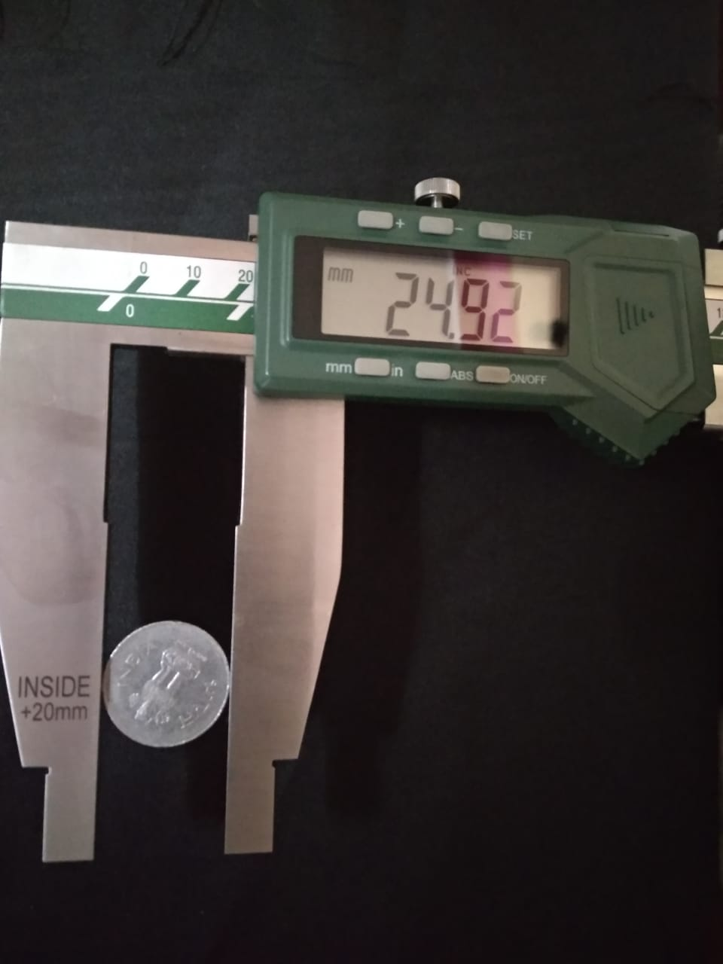
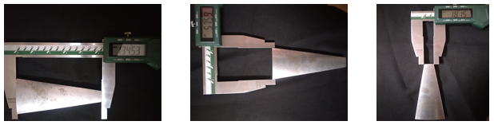
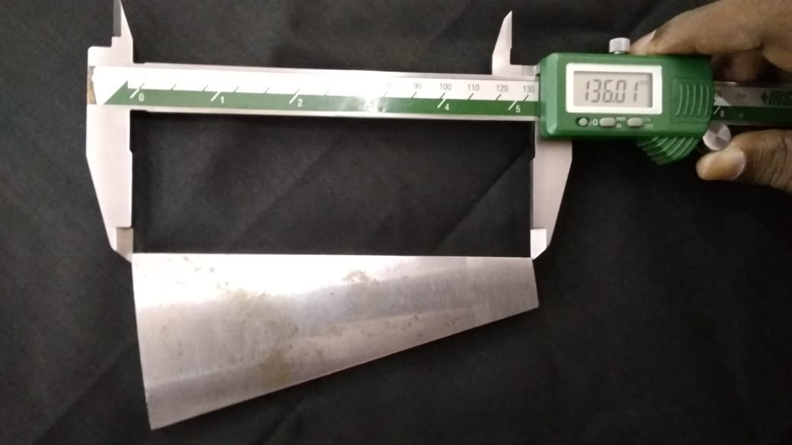
Outcomes
Working model
Figure 2.1 shows the chosen reference object (Standard one-rupee coin) whose diameter is 24.92 mm (milli meter) which will be given as an input parameter to our python program.
Figure 2.1
Figure 2.2
Figure 2.2 shows actual dimensions of the object chosen as 136.01 mm, 57.59 mm and 18.15 mm respectively for the images from left to right. Dimensions are taken with help of high precision Vernier calliper which is used in an industry

Slide 42
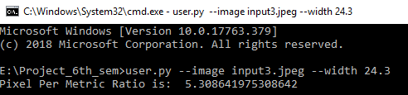
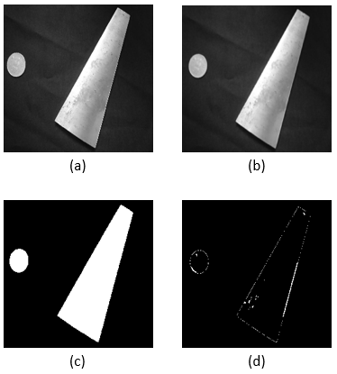
Outcomes
Figure 2.3
Figure 2.3 in this location of input image and width of reference object is given by user
Figure 2.4 shows stages of pre-processing of an input image (a) shows the grey image, (b) shows the blurred grey image, (c) shows the threshold image and (d) shows identified edges of input image which will then help in determining the contours and find dimensions of object.
Figure 2.4

Slide 43
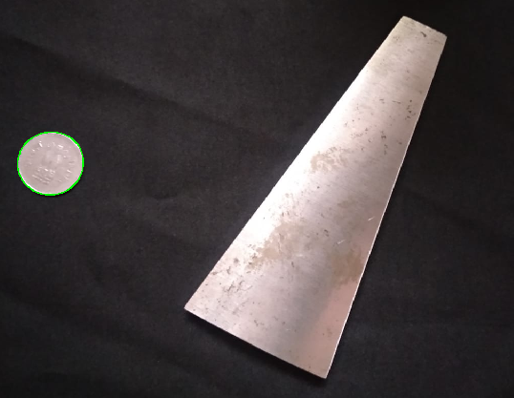
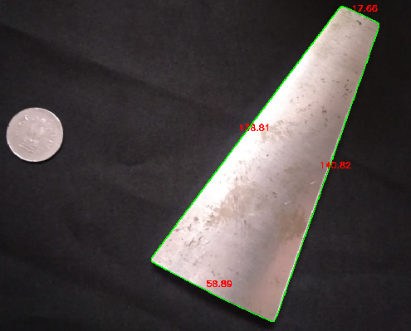
Outcomes
Figure 2.5 shows that the reference object (one-rupee coin) has been identified from the input image.
Figure 2.5
Figure 2.6 is the final output of the python program where dimensions of the object are calculated and printed on the image. The dimensions shown are 58.59 mm, 138.81 mm, 17.66 mm and 140.82 mm
Figure 2.6

Slide 44
Outcomes
Real dimensions | Output dimensions (from image) | Difference | Accuracy
18.15 mm | 17.66 mm | 0.49 mm | 97.3 %
57.59 mm | 58.89 mm | 1.30 mm | 97.8 %
136.01 mm | 138.81 mm and 140.82 mm | 2.80 mm and 4.81 mm | 97.2 %
Table 1.1
Table 1.1 shows the accuracy of the project it almost maintains an accuracy of 97.43 % on an average.

Slide 45
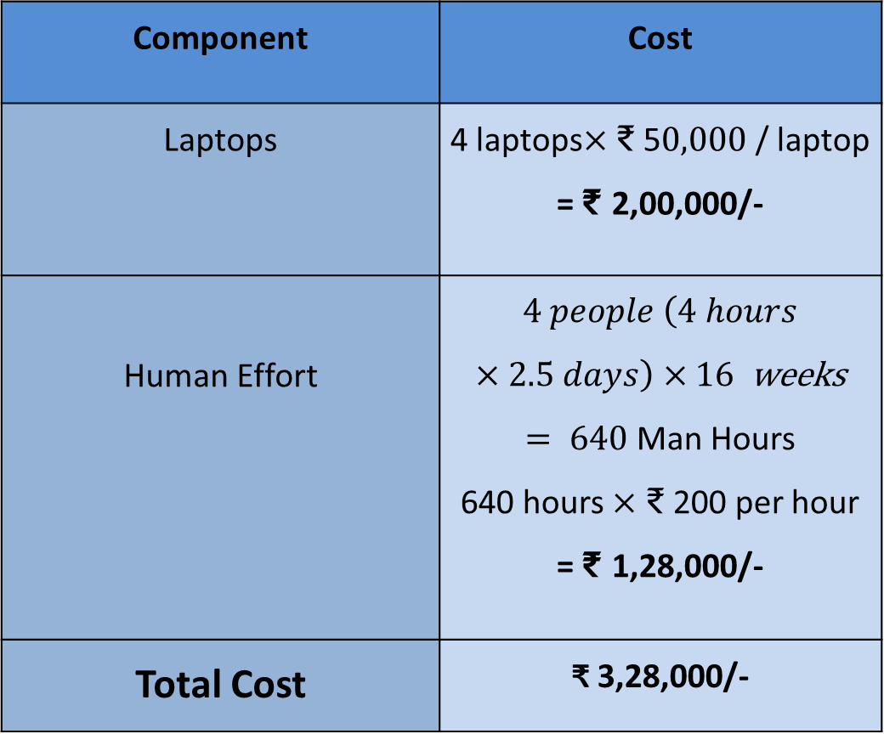
Project Costing
Component | Cost
Laptops | 4 laptops$×$ ₹ 5$0,000$ / laptop = ₹ 2,00,000/-
Human Effort | $4 people \left(4 hours×2.5 days\right)×16$ weeks $= 640$ Man Hours 640 hours $×$ ₹ 200 per hour = ₹ 1,28,000/-
Total Cost | ₹ 3,28,000/-

Slide 46
Conclusions
The method used here is to estimate the dimensions of an object using image processing and using a reference object method which is discussed earlier.
This method works well indicated by the accuracy shown. The availability of open-source well structured libraries in python has been used to achieve this.
It requires that object is easily distinguishable from the background and the background has no visible edges. However, as a future work, depth analysis can be used as a solution.

Slide 47
References
Ali, Yasir & Malik, Aamir. (2012). Depth and Geometry from a Single 2D Image Using Triangulation. Proceedings of the 2012 IEEE International Conference on Multimedia and Expo Workshops, ICMEW 2012. 511-515. 10.1109/ICMEW.2012.95.
Adrian Rosebrock (2016). Measuring size of objects in an image with OpenCV[Online]. Available at: https://www.pyimagesearch.com/2016/03/28/measuring-size-of-objects-in-an-image-with-opencv/ (Accessed: 5th February 2019)

Slide 48
References
A. Criminisi, I. Reid, and A. Zisserman, “Single View Metrology,” International Journal of Computer Vision, vol. 40, no. 2, pp. 123-148, 2000.
Peng, K., Hou, L., Ren, R., Ying, X., & Zha, H. (2010). Single View Metrology Along Orthogonal Directions. 2010 20th International Conference on Pattern Recognition. doi:10.1109/icpr.2010.410
Johnson, Forrest. (2010). “How to measure the size of an object using camera” [Online].Journal. Available at: https://web.archive.org/web/20131123073926/http://forestjohnson.blogspot.com/2010/01/how-to-measure-size-of-object-using.html [ Accessed: 24 Mar. 2019].

Slide 49
References
Fernandes, L., Oliveira, M., da Silva, R. and Crespo, G. (2006). A fast and accurate approach for computing the dimensions of boxes from single perspective images.
Meysenburg, M. (2016). Image Processing: Edge Detection. [online] mmeysenburg.github.io. Available at: https://mmeysenburg.github.io/image-processing/08-edge-detection/ [Accessed 26 Mar. 2019].
Rosebrock, A. (2016). OpenCV shape detection - PyImageSearch. [online] PyImageSearch. Available at: https://www.pyimagesearch.com/2016/02/08/opencv-shape-detection/ [Accessed 26 Mar. 2019].

Slide 50
Demonstration
Demonstration will be shown to the panel.

Slide 51
Work Load Allocation
 | Shivakumar M | Shridhar Hegde | Santosh G | Sai Bharadwaj
Literature Survey
Documentation
Requirements analysis
Designing
Implementation
Testing
Performance Analysis

Slide 52
Team Experience
Helen Keller(American author) once said, "Alone we can do so little; together we can do so much”.
It was a great experience working in a team to achieve a common goal. We can foster creativity and learning skills by working in a team.
Out Conflict resolution skills have been developed by working in a team since 9 weeks as we always try to resolve difference of opinions by dialogue and coming to logical conclusions.

Slide 53
Report Writing and Uploading Product video on Youtube

Slide 54
Thank You

